Slide 1
City of Portland
Master Address Repository
Intro and Data Cleanup Efforts
Jake Brown Presenting
GIS In Action – Lightning Talk

Slide 2



About Jake Brown
First lightning talk
Computer science emphasis in GIS at Eau Claire Wisconsin
Moved to Portland in 2008 BPA GIS – 6 years
City of Portland Bureau of Development Services
Big fan of web maps, python and mapping everything
3 dogs
Recently engaged

Slide 3
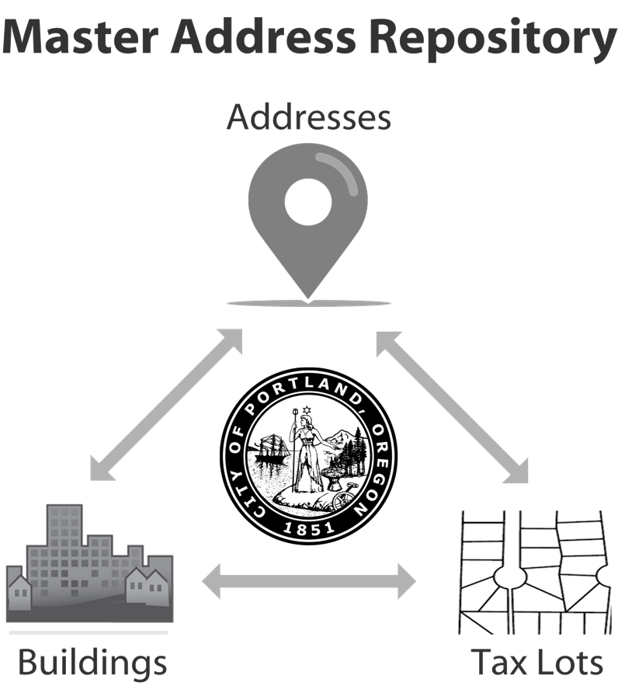
Portland’s New Master Address Repository?

Slide 4
Master Address Repository: what,why, who, how
Relational database that associates addresses, buildings and tax lots.
The City of Portland recognized the need of a single source of record for addressing to share within the city and regional data subscribers
MAR captures change as we need to manage property data life cycle.
Portland’s Bureau of Development Services add new addresses into the MAR using ArcMap based tools.
Loading MAR with data and cleaning up the initial baseline
Sophisticated metrics grade and flag data discrepancies

Slide 5
Where did the data come from?
Address points:
County tax lots centroid @ 225k
USPS – apartments and multi-dwelling @ 100k
City of Portland’s permitting system @ 13k
Building Footprints:
Derivative of LiDAR data and digitized footprints
Taxlot polygon:
Counties (Multnomah,Washington,Clackamas)

Slide 6
Paint an Address Accuracy Picture
Combination of quantify and qualify to identify issues with address point location -- metric framework allows for more sources
SQL Server Geometry type allows us to detect how or address point is spatially related to anything other shape.
5 Metrics sources currently, adding more is as simple as connecting the dots
Address accuracy goal:
Rank address by accuracy score 0-10 (10 is perfect)
Residential – address point should be on associated dwelling unit building
Commercial – address point should be located at door or on tenant space
Let’s Jump In…

Slide 7
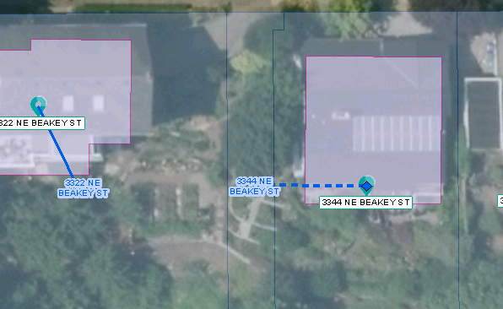
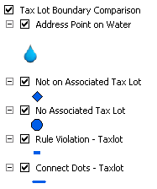

How Do Address Points Relate to County Tax Lots?
Scoring Criteria
Is the associated address point within the same tax lot it’s associated with in the MAR?
3 POINTS
If there is not taxlot, is the address point in a hydro body?
3 POINTS
We can connect the dots from the associated building centroid to the address point. That’s line should not cross the tax lot boundary

Slide 8
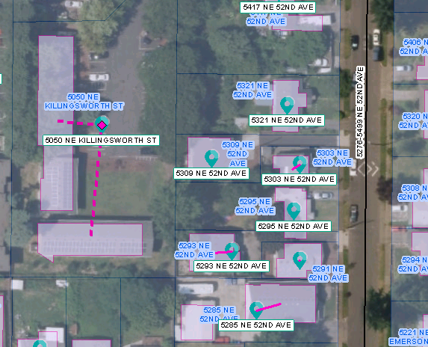
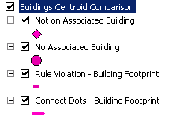
How do Address Points Relate to PDX Building Footprints
Scoring Criteria
Is the address point associated within the same building it’s associated with in the MAR? Garages are ignored. 1 POINT

Slide 9
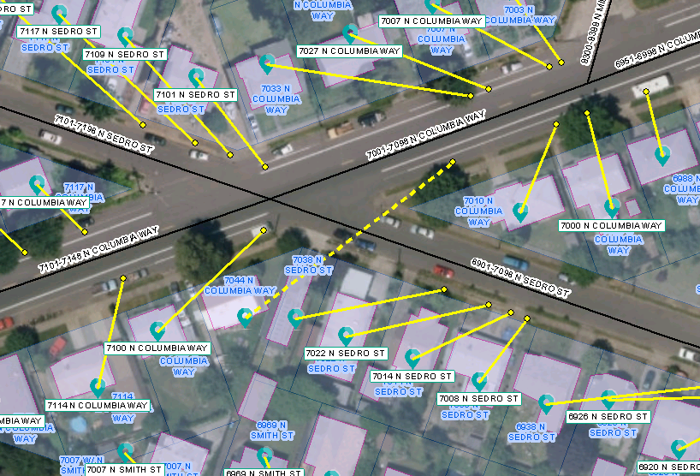
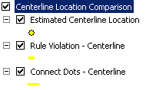
How do Address Points Relate to PDX Street Centerline
The city maintains a detailed centerline dataset that is used as the basis for new addresses.
This dataset is updated frequently and published through a centerline. We can programmatically query (python) into the geocoder and get an “estimated location” for each address string.
Scoring Criteria
If we “connect the dots” from the estimated location to our address point, that resulting line should not cross a street. 2 points

Slide 10
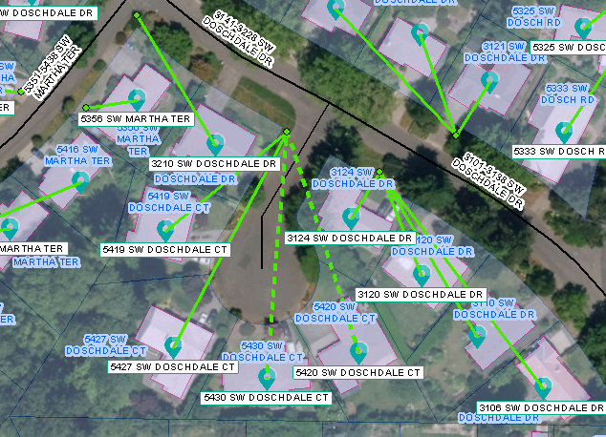
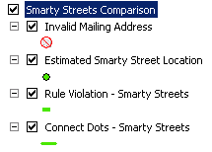

How do Address Points Relate to External Resource: Smarty Streets
Smarty Streets is a web based address verification API that checks to see if addresses are deliverable. It also gives us an estimated location based on tiger centerline data.
Key Benefits
Only metric for valid mailing
Good for multi-dwelling
Bonus attribute data
Scoring Criteria
Is the address is a valid mailing address with smarty streets? 1 point
Is the address location on the same side of the street as MAR address location? 1 point

Slide 11
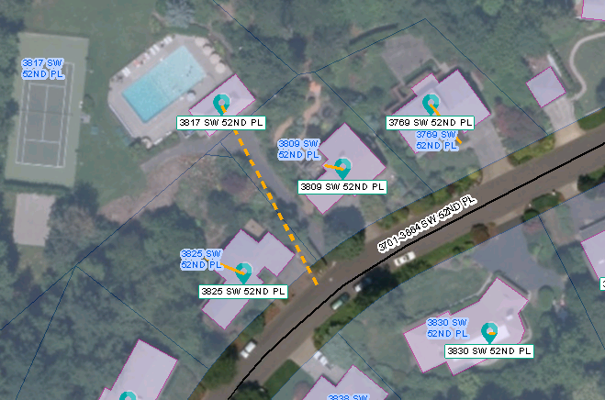
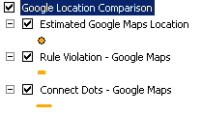
How do Address Points Relate to External Resource: Google Maps
Google maps API has a free geocoding service that allows you to search for an address – if found it returns location and other details.
Key Limitations
rooftop and range interpolated matches better
2500 queries a day (for free service)
Not good for multi-dwellings
Scoring Criteria
The google maps location should be on the same side of the street as our address point. 1 point
The google maps location should be within the same tax lot as our address point. 1 point

Slide 12
Address Accuracy Scoring Recap
Metric | Points Awarded
Address Point within correct Tax Lot | 3
Address Point within Building Footprint | 1
Address Point on same side of street as estimated centerline location | 2
Address Point related to estimated google maps location | 2
Address description valid mailing address (according to smarty streets) | 1
Address Point on same side of street as estimated Smarty Streets Location | 1
Completely Inaccurate Address – 0 points
1st round review minimum passing score – 6 points
Perfect Score – 10 points
*not all google data processed – we are limited to processing 2500 points per day.

Slide 13
Picture Painted…Now Let’s Fix the Data
MAR data lives on SQL server 2008 database. Our shape fields are of type <geometry> this means that we can edit the shape field using SQL update statements.
The trick is to create “business rules” that we can script into SQL statements, identifying error patterns, isolating those records and updating shapes to correct the errors.
Address point has no associated tax lot, but it’s on tax lot and the address does not violate the centerline rule?
We can associate the address point with spatially coincident tax lot
Address point has no associated building, but it’s on building and the address does not violate the centerline rule?
We can associate the address point with spatially coincident building
Only one building on tax lot?
address point should be on that building
Only one house and one garage on tax lot?
address point should be on the house
Addresses should be unique - delete duplicates

Slide 14
Manual Corrections
Thousands of records will still need to be reviewed and fixed by a human. We can make that job easier by “painting the accuracy picture” of each address point. Users can see all relevant metrics for each address so they can focus on fixing one address at a time. We can build notification systems that will track an address through its accuracy life cycle.
Correction Workflows
Level one editors – first pass review if the edit is straightforward, they fix, if the edit takes more than a couple minutes to resolve or advanced research they can escalate to level 2
Level two editors- address editing subject matter expert, have knowledge of permitting system. Can request centerline edit or field review. Use an ArcMap DME to make edits.
Centerline edit needed – in some cases our centerline network may need updating. The address cleanup effort should force centerline errors to surface.
County tax lot info needs updating – send report to county GIS team
Building footprint missing – initial building creation process
Field review needed – walk/drive/bike around to a location and figure our what’s going on.
Re-run metrics
After any address point is moved, metrics are re-run

Slide 15
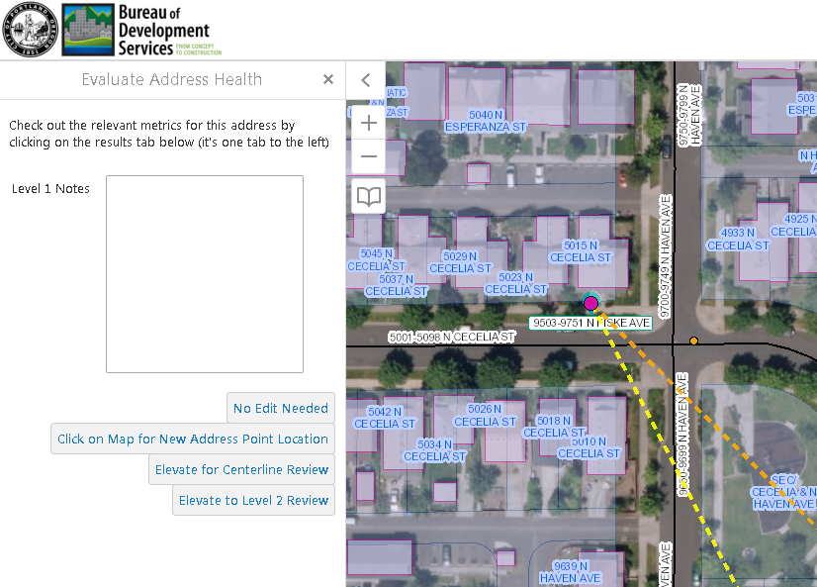
Web Editing App Tier 1 Editor

Slide 16
Feedback Loop Process for users to suggest address reviews
Portland Maps user internal/external wants address reviewed
User is notified to review details
Review request gets queued at the top of list for Tier 2 review
Address is review and update is made if needed

Slide 17
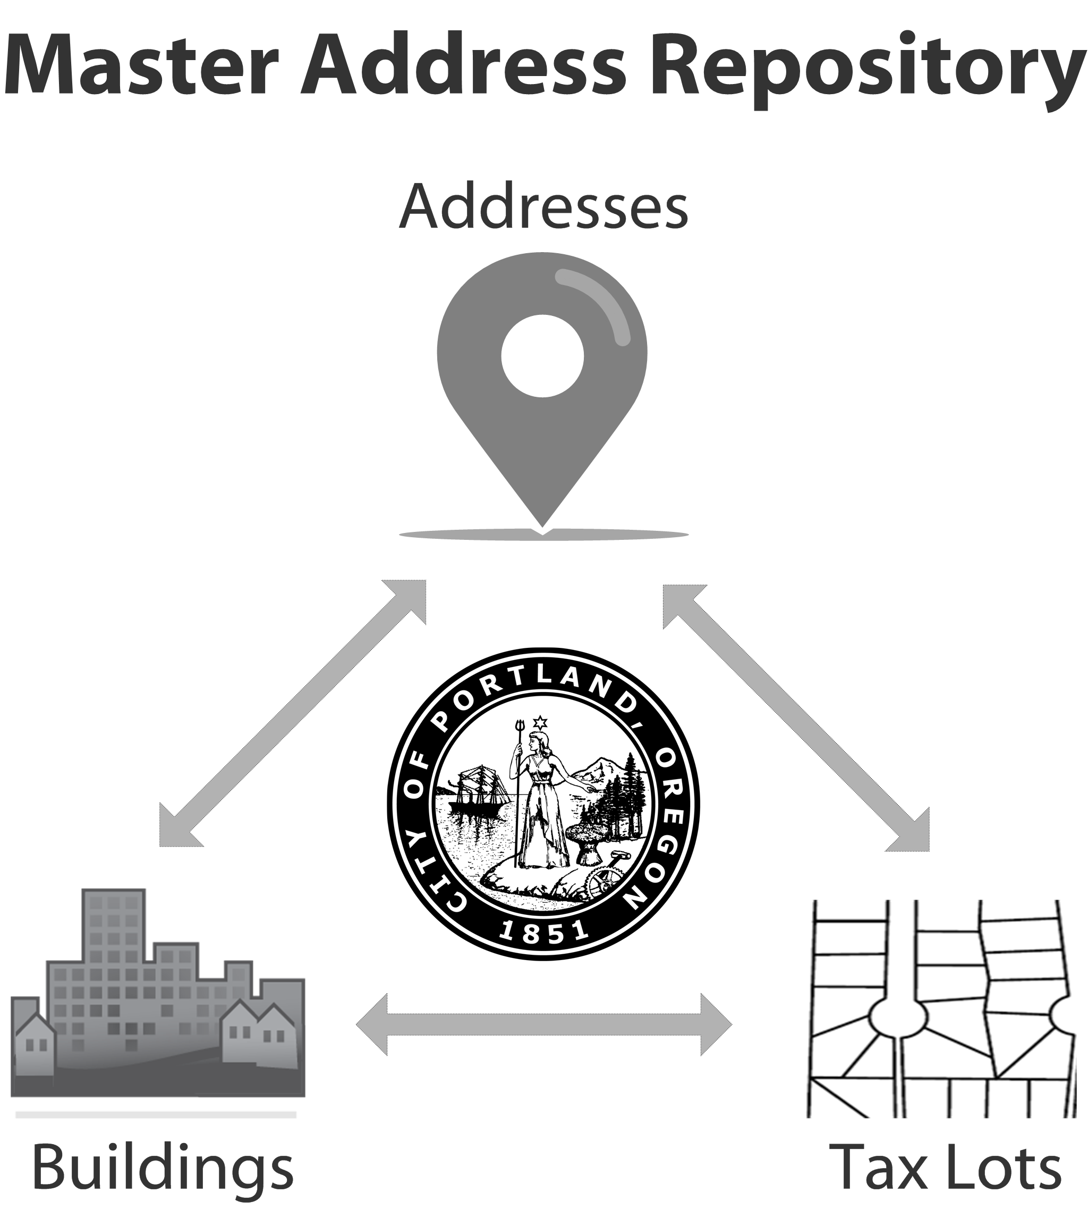
Questions?
Jake.Brown@PortlandOregon.gov
Want Scripts?
https://github.com/pdxgis/MAR-tools

